Slide 1

CS6611 – CREATIVE AND INNOVATIVE PROJECT
ELECTION SENTIMENT ANALYSIS
Done by,
R A Nithish Kumar – 2021103548
Aravind Krishnan S – 2021103509
T V Pavishek – 2021103721

Slide 2
PROBLEM STATEMENT
Traditional methods like polls struggle to capture the real time pulse of public opinion during elections .
Social media offers a massive dataset , but analysing it efficiently is difficult due to volume , complexity and bias.
The proposal is to develop and apply advanced NLP techniques like sentiment analysis to automatically classify and analyse opinions expressed in election-related tweets.
Sentiment analysis can automatically classify opinions(positive,negative,neutral) expressed in election-related text, offering valuable insights.

Slide 3
OBJECTIVES
General objectives
Understanding public opinion
Predicting election outcomes
Enhancing democratic processes
Specific objectives
Identify and categorize the key issues driving public sentiment for each candidate or party.
Develop a sentiment analysis model that can accurately classify text data (e.g., tweets, news articles) as positive, negative, or neutral towards specific candidates or parties.
Analyze the volume of positive, negative, and neutral sentiment over time to identify trends in public opinion throughout the election cycle.

Slide 4
INTRODUCTION
In the ever-evolving landscape of political discourse, the ability to gauge public sentiment accurately has become increasingly vital, especially during elections. Traditional methods such as polls often struggle to capture the real-time pulse of public opinion, while social media platforms offer a vast reservoir of data that reflects the thoughts and feelings of millions. However, harnessing this data efficiently poses a significant challenge due to its sheer volume, complexity, and inherent biases.
This research endeavors to bridge this gap by leveraging advanced Natural Language Processing (NLP) techniques, particularly sentiment analysis, to automatically classify and analyse opinions expressed in election-related tweets. Sentiment analysis, a subset of NLP, holds the promise of automatically categorizing opinions as positive, negative, or neutral, thereby providing valuable insights into the collective mood of the electorate.
By harnessing the power of NLP, this study aims to unlock the potential of social media as a rich source of real-time, granular data on public sentiment during elections. Through the systematic analysis of vast amounts of textual data, this research seeks to offer policymakers, analysts, and the public a nuanced understanding of the prevailing sentiments, enabling informed decision-making and a deeper comprehension of the electoral landscape.

Slide 5
LITERATURE REVIEW
Li et al,2020[4]. introduce a sentiment information based network model (SINM) for Chinese text sentiment analysis. Their approach incorporates transformer encoder and LSTM components. However, the effectiveness of the model heavily relies on the quality and quantity of the training data, potentially impacting accuracy if the data doesn't capture the nuances of Chinese sentiment expression accurately.
Woldemariam, Y,2022[2]. presents a cross-media analysis framework for sentiment analysis. The pipeline includes components like a chat room cleaner, NLP, and sentiment analyzer. Leveraging the Apache Hadoop framework and Stanford CoreNLP library with the Recursive Neural Tensor Network (RNTN) model, their approach acknowledges the diverse expressions of sentiment across different media. For instance, while a frowning emoji in text typically conveys negativity, the same expression in a video might indicate concentration or contemplation, highlighting the complexity of cross-media sentiment analysis.
Ilmania, A et al,2023[4] introduce a deep neural network approach for aspect detection and sentiment classification in Indonesian text. Their methodology includes two approaches for sentiment classification: one utilizing word embedding, sentiment lexicon, and POS tags with bi-GRU topology, and the other employing an aspect matrix to rescale word embedding vectors with CNN topology. However, effective ABSA models necessitate a substantial 16 amount of accurately labelled Indonesian training data, encompassing both aspects and sentiment polarities, posing a challenge for model development.
Fujihira, et al,2019[3] propose a multilingual sentiment analysis method relying on wordto-word translation using a sentiment dictionary from any native language. They conducted sentiment classification experiments on tweets in English, German, French, and Spanish. However, they caution that languages convey sentiment nuances differently, and direct word-to-word translation may overlook subtleties like sarcasm, irony, and cultural references, potentially resulting in inaccurate sentiment classification. Wang, Z et al,2023[8] present a social media analytics engine capable of fine-grained sentiment analysis and emotion sensing. Their method utilizes a social adaptive fuzzy similarity-based classification approach to automatically categorize text messages into sentiment categories (positive, negative, neutral, and mixed), while also identifying prevailing emotion categories (e.g., satisfaction, happiness, excitement, anger, sadness, and anxiety). However, they acknowledge the challenge posed by ambiguous language, slang, sarcasm, and context-specific expressions commonly found in social media posts, which can hinder the accurate interpretation of sentiment by analysis algorithms.

Slide 6
Title | Methodology | Limitations
Li, G., Zheng, Q., Zhang, L., Guo, S., & Niu, L. (2020, November). Sentiment infomation based model for chinese text sentiment analysis. In 2020 IEEE 3rd international conference on automation, electronics and electrical engineering (AUTEEE) (pp. 366-371). IEEE. | This paper proposes a sentiment information based network model(SINM). We use Transfomer encoder and LSTM as model components. | These models rely heavily on the quality and size of the training data. If the training data doesn't accurately reflect the nuances of Chinese sentiment expression, the model's accuracy will suffer.
Woldemariam, Y. (2016, March). Sentiment analysis in a cross-media analysis framework. In 2016 IEEE international conference on big data analysis (ICBDA) (pp. 1-5). IEEE. | The pipeline includes the following components; chat room cleaner, NLP and sentiment analyzer. we use the apache-hadoop framework with its lexicon-based sentiment prediction algorithm and Stanford coreNLP library with the Recursive Neural Tensor Network (RNTN) model. | Sentiment can be expressed differently across media. A frowning emoji in text is a clear negative sign, but a frown in a video might indicate concentration or contemplation.
Ilmania, A., Cahyawijaya, S., & Purwarianti, A. (2018, November). Aspect detection and sentiment classification using deep neural network for Indonesian aspect-based sentiment analysis. In 2018 International Conference on Asian Language Processing (IALP) (pp. 62-67). IEEE. | On sentiment classification, we also compare two approaches of deep neural network. The first approach uses word embedding, sentiment lexicon and POS tags as the input vector, with bi-GRU based as the topology. The second one uses aspect matrix to rescale the word embedding vector as the input vector and convolutional neural network (CNN)based as the topology. | ABSA models require a large amount of high-quality Indonesian training data. This data needs to be labeled with both the aspects and their sentiment polarities.

Slide 7
Fujihira, K., & Horibe, N. (2020, September). Multilingual sentiment analysis for web text based on word to word translation. In 2020 9th International Congress on Advanced Applied Informatics (IIAI-AAI) (pp. 74-79). IEEE. | we design a multilingual sentiment analysis method based on word to word translation using a sentiment dictionary in arbitrary native language. We conduct a sentiment classification experiment for tweets in English, German, French, and Spanish. | Languages express sentiment in nuanced ways. Direct word-to-word translation often fails to capture these subtleties. Sarcasm, irony, and cultural references can be misinterpreted, leading to inaccurate sentiment classification
Wang, Z., Chong, C. S., Lan, L., Yang, Y., Ho, S. B., & Tong, J. C. (2016, December). Fine-grained sentiment analysis of social media with emotion sensing. In 2016 Future technologies conference (FTC) (pp. 1361-1364). IEEE. | This paper describes a social media analytics engine that employs a social adaptive fuzzy similarity-based classification method to automatically classify text messages into sentiment categories (positive, negative, neutral and mixed), with the ability to identify their prevailing emotion categories (e.g., satisfaction, happiness, excitement, anger, sadness, and anxiety). | Social media posts often contain ambiguous language, slang, sarcasm, and context-specific expressions that can be challenging for sentiment analysis algorithms to interpret accurately.

Slide 8
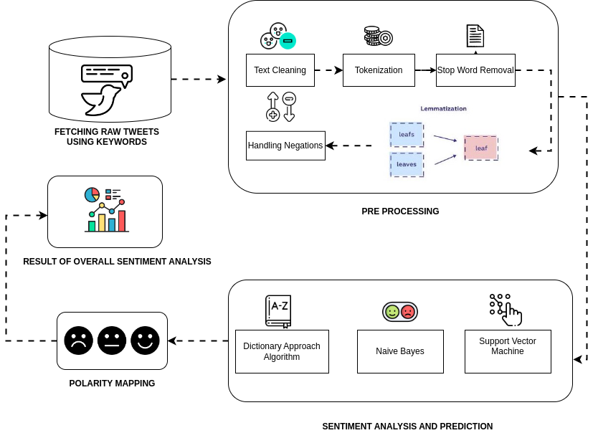
SENTIMENT ANALYSIS

Slide 9
SYSTEM DESIGN
1. DATA COLLECTION AND PRE PROCESSING
Data Sources Identification Identify and select relevant sources of textual data related to the election, including social media platforms (Twitter) where discussions about the election are taking place.
Data Filtering Filter the collected data to include only relevant content related to the election. This may involve applying keyword filters, topic filters, or other criteria to ensure that the dataset is focused on election-related discussions.
Data Cleaning Clean the collected data to remove noise, irrelevant information, and formatting inconsistencies. This includes tasks such as removing HTML tags, special characters, URLs, and other non-textual elements. Text Pre-processing: Pre-process the textual data to prepare it for sentiment analysis. This involves tasks such as tokenization (splitting text into words or tokens), removing stop words (common words that do not carry significant meaning), stemming (reducing words to their root form), and lemmatization (converting words to their base or dictionary form).
Normalization Normalize the pre-processed text data to ensure consistency and comparability across different sources and formats. This may involve standardizing text encoding, converting text to lowercase, and handling variations in spelling or punctuation.

Slide 10
2.SENTIMENT ANALYSIS
Text Tokenization Split the pre-processed text data into individual words or tokens, which are the basic units of analysis for sentiment analysis.
Sentiment Lexicon Usage Utilize sentiment lexicons or dictionaries containing words annotated with their sentiment polarity (positive, negative, neutral). These lexicons assign a sentiment score to each word based on its semantic meaning.
Sentiment Classification Classify the sentiment of each document or text snippet into categories such as positive, negative, or neutral based on the calculated sentiment score. Thresholds may be defined to determine the boundaries between these categories.
Contextual Analysis Consider the context in which words or phrases are used to improve the accuracy of sentiment analysis. Contextual factors such as negation (e.g., "not happy"), intensifiers (e.g., "very happy"), and idiomatic expressions are taken into account.
Visualization Visualize the results of sentiment analysis using charts, graphs, or heatmaps to illustrate sentiment distributions, trends over time, or differences across topics or demographics.

Slide 11
3. Polarity Mapping
Topic Identification The module identifies and extracts relevant topics or issues discussed in the textual data. This could involve techniques such as keyword extraction, topic modelling, or clustering algorithms to group related content.
Sentiment Score Assignment For each identified topic or issue, the module assigns sentiment polarity scores based on the sentiment analysis results obtained from the Sentiment Analysis module. This involves aggregating sentiment scores associated with the topic's text data.
Polarity Mapping The module maps the sentiment polarity scores to predefined categories or dimensions relevant to the election context. For example, sentiment scores may be mapped to categories such as candidate support, policy preferences, campaign effectiveness, or electoral trust.
Visualization It visualizes the mapped sentiment polarity scores using graphical representations such as bar charts, heatmaps, or spider diagrams. This allows stakeholders to easily interpret the sentiment distribution across different topics or dimensions.

Slide 12
4. PREDICTION
Model Training The module trains machine learning models using the prepared historical data and selected features. Commonly used models include Naïve Bayes Classifier , support vector machines (SVM), or neural networks.
Visualization and Reporting The module visualizes the prediction results using charts, graphs, or dashboards to communicate the forecasted sentiment trends and electoral predictions to stakeholders. Additionally, it generates reports summarizing the prediction accuracy and highlighting key insights.

Slide 13
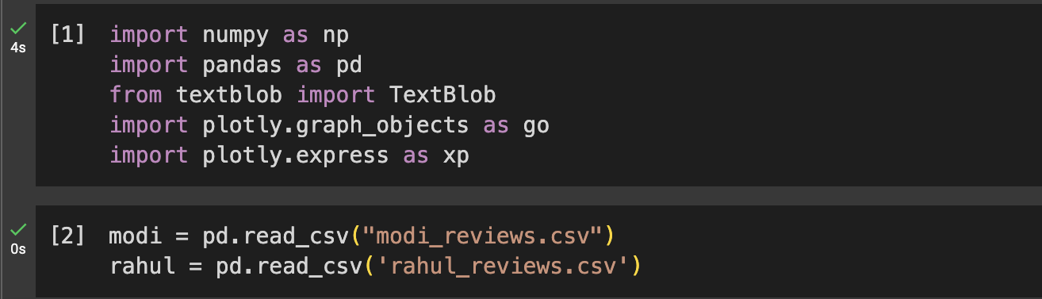
IMPLEMENTATION
Module 1 -Data Collection and Pre-processing
1. Import datasets
https://github.com/pavishek2004/CIP-project/blob/main/modi_reviews.csv
https://github.com/pavishek2004/CIP-project/blob/main/rahul_reviews.csv

Slide 14
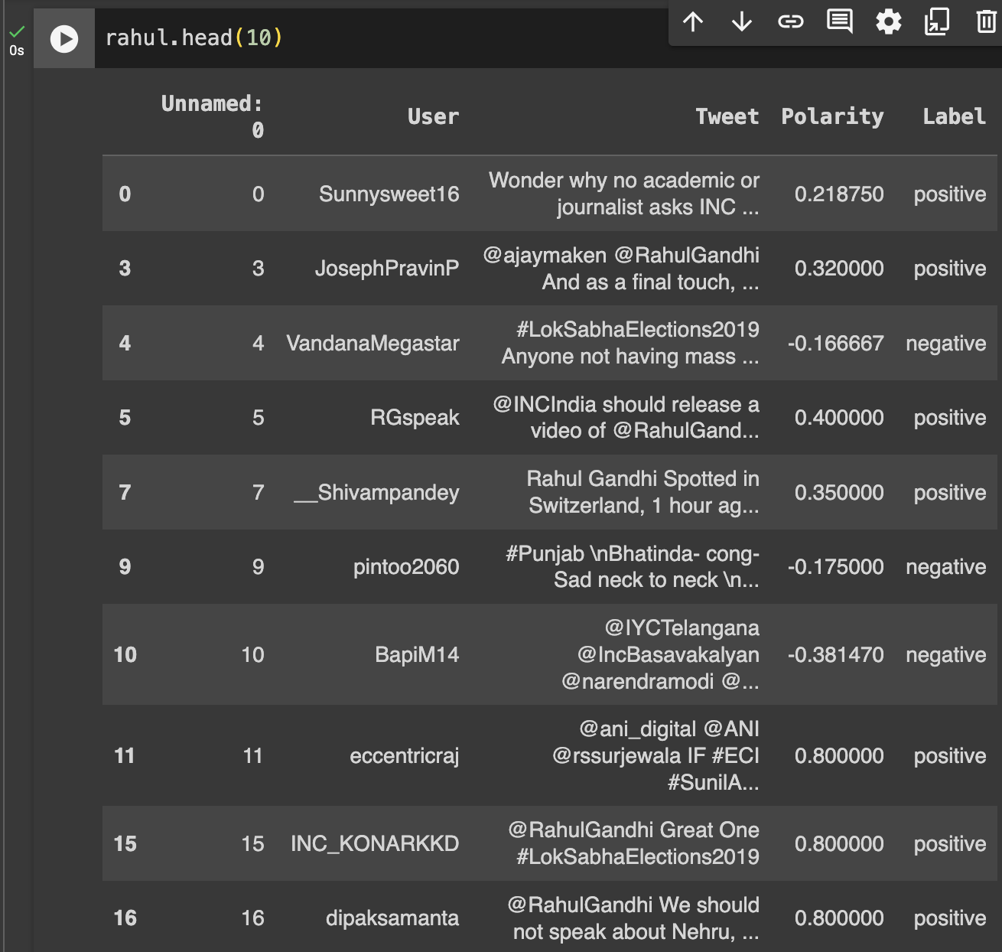
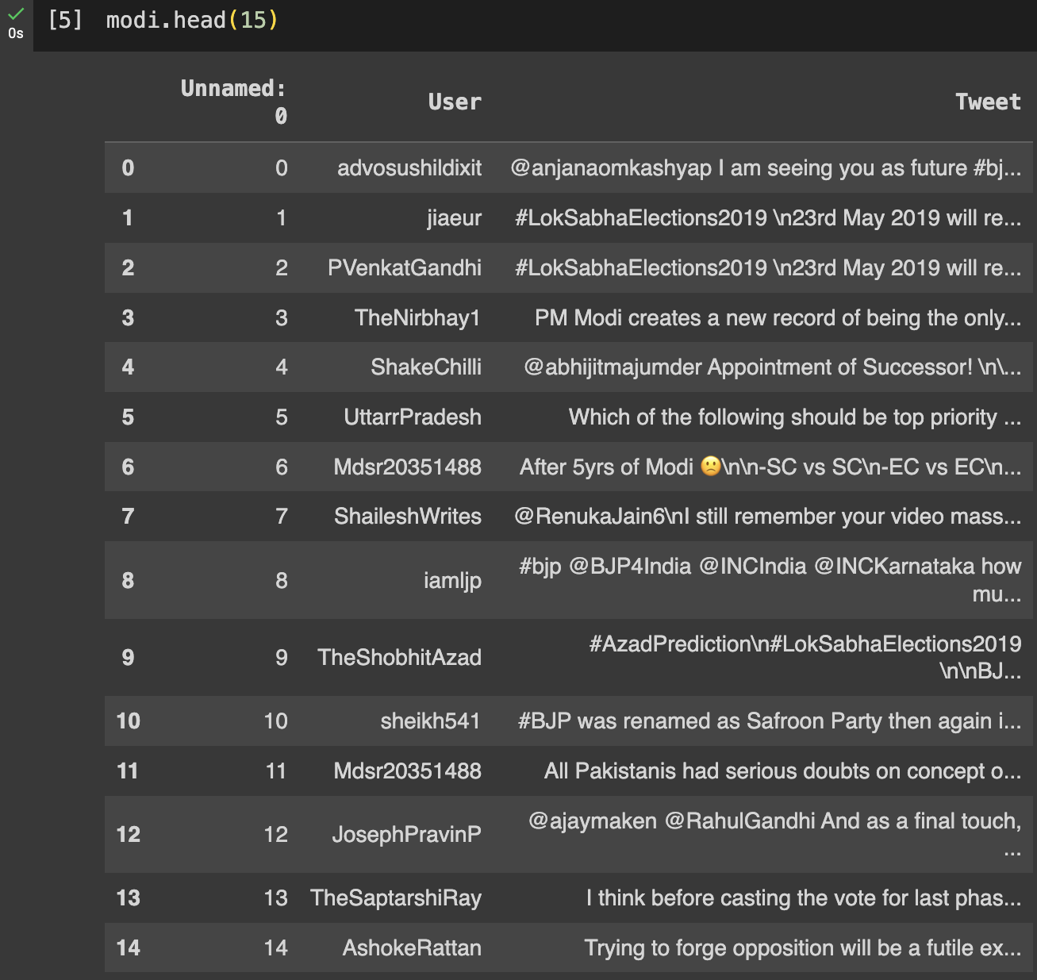
2.Inspecting Dataset

Slide 15
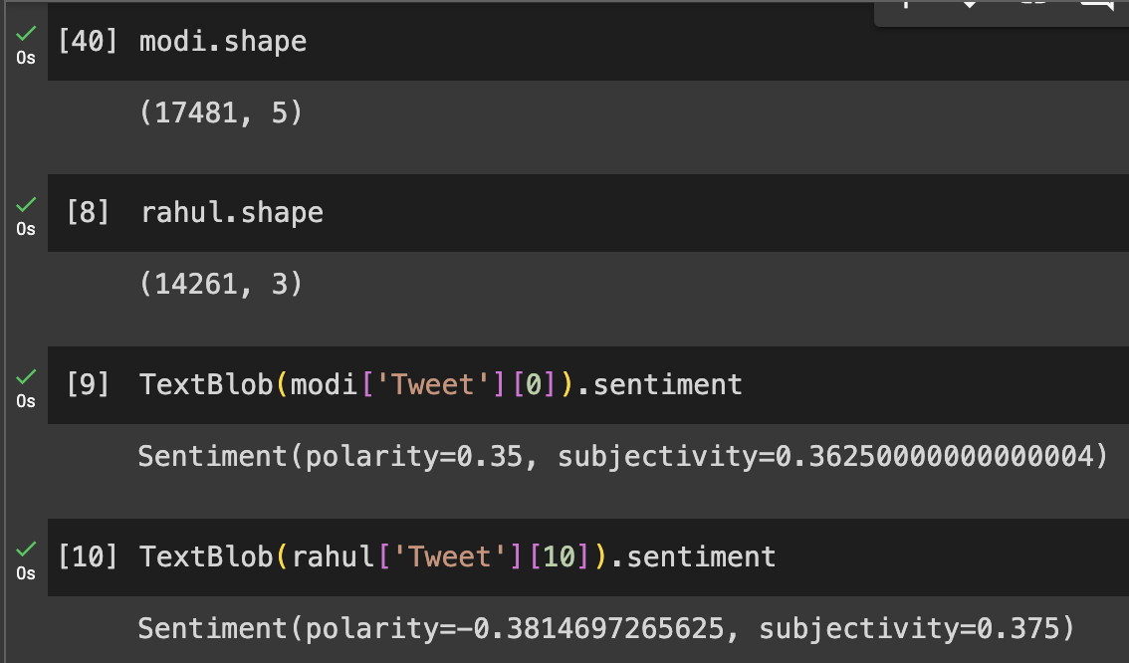
3. Fetching Sentiment Scores of the tweets
Module 2 – Sentiment Analysis

Slide 16
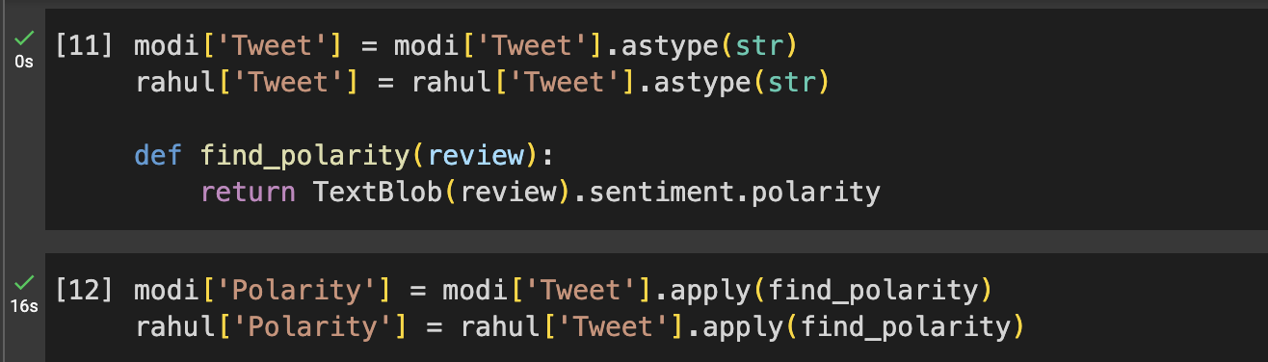
4. Generating the polarity of the tweets

Slide 17
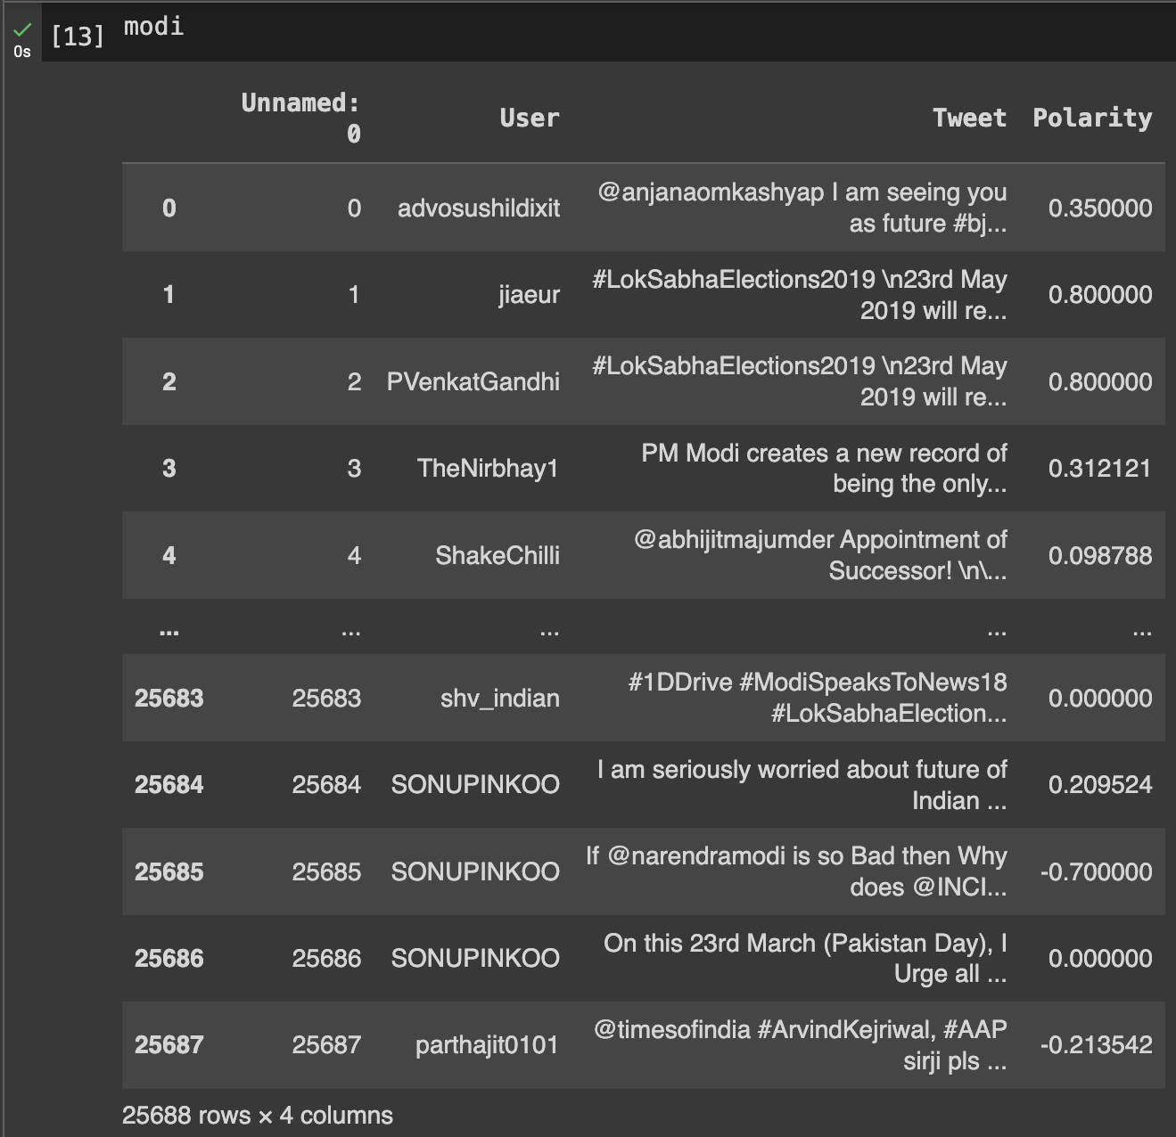
4. Generating the polarity of the tweets

Slide 18
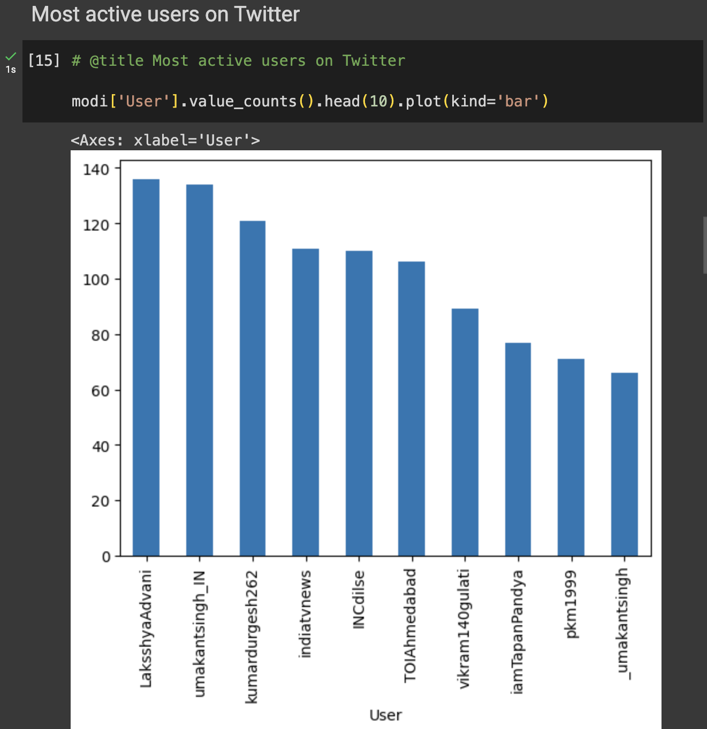
4. Generating the polarity of the tweets

Slide 19
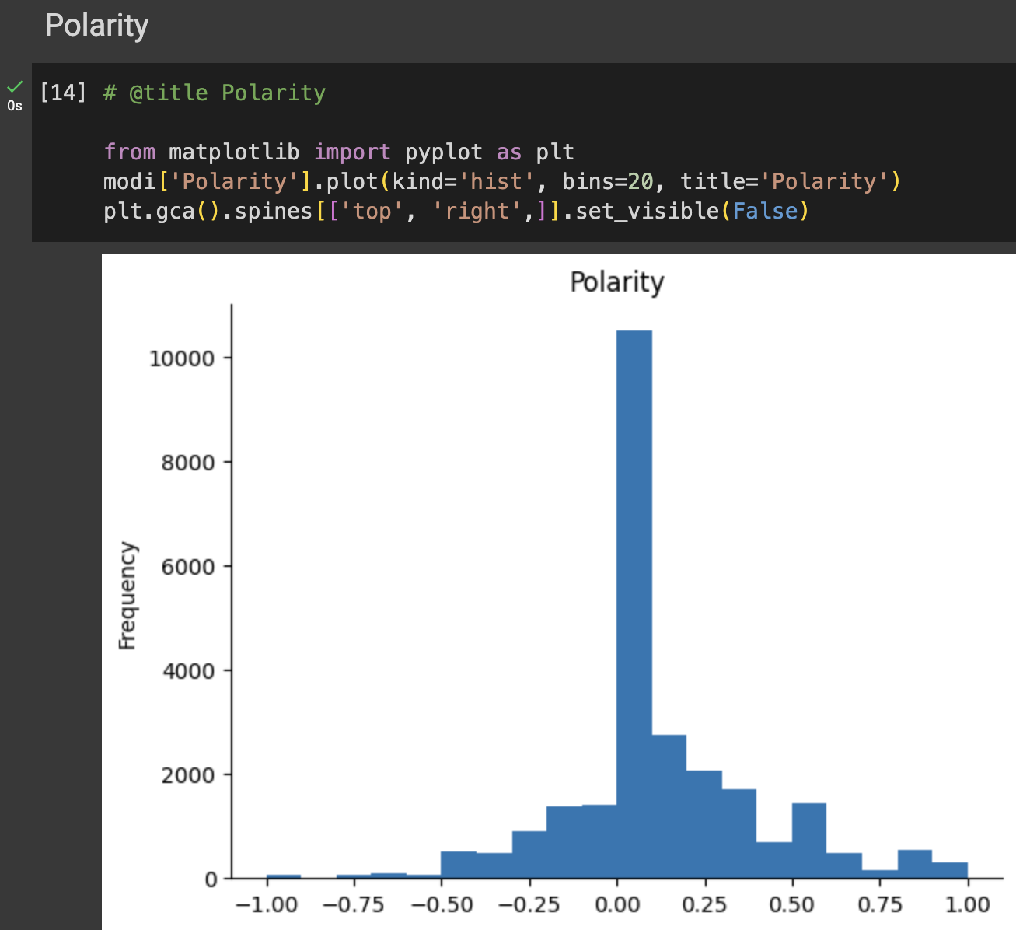
4. Generating the polarity of the tweets

Slide 20
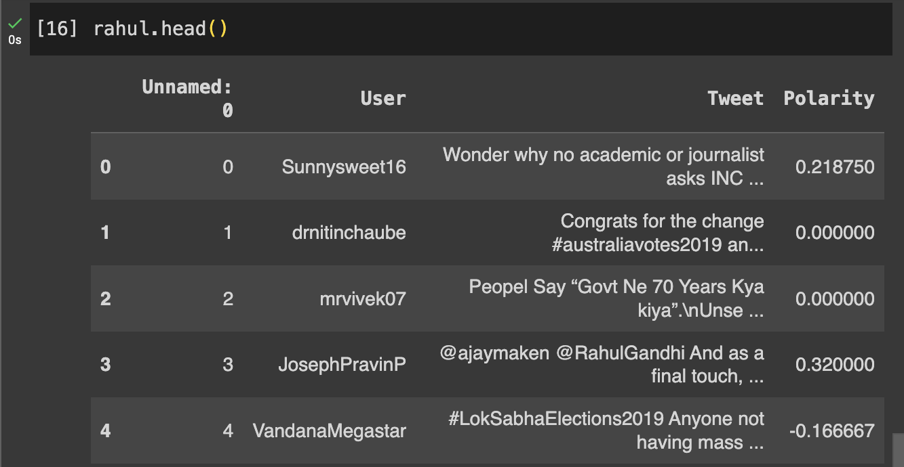
4. Generating the polarity of the tweets

Slide 21
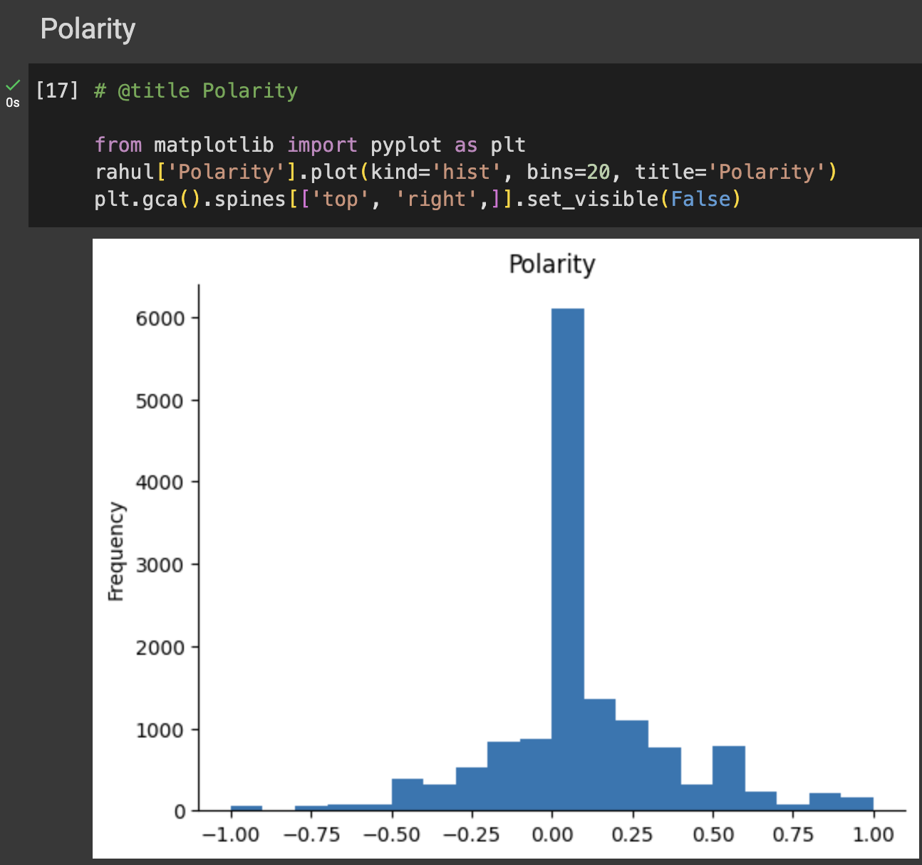
4. Generating the polarity of the tweets

Slide 22
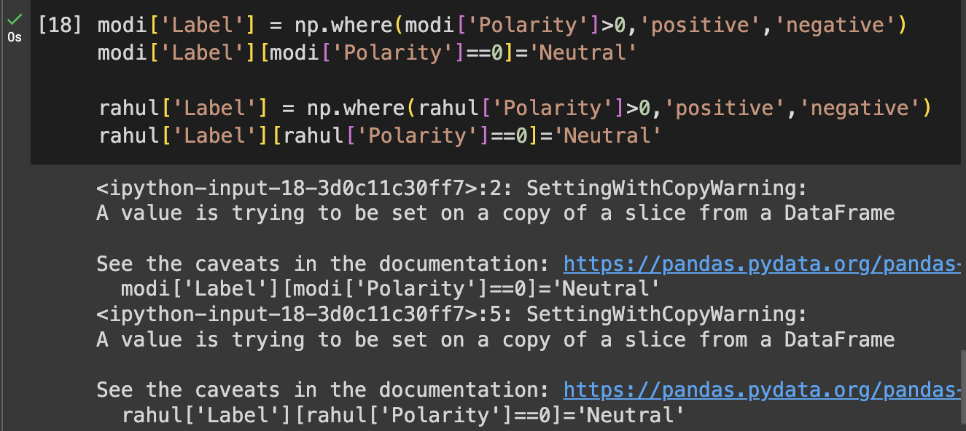
Module 3 – Polarity Mapping
5.Categorizing the tweets based on their polarity

Slide 23
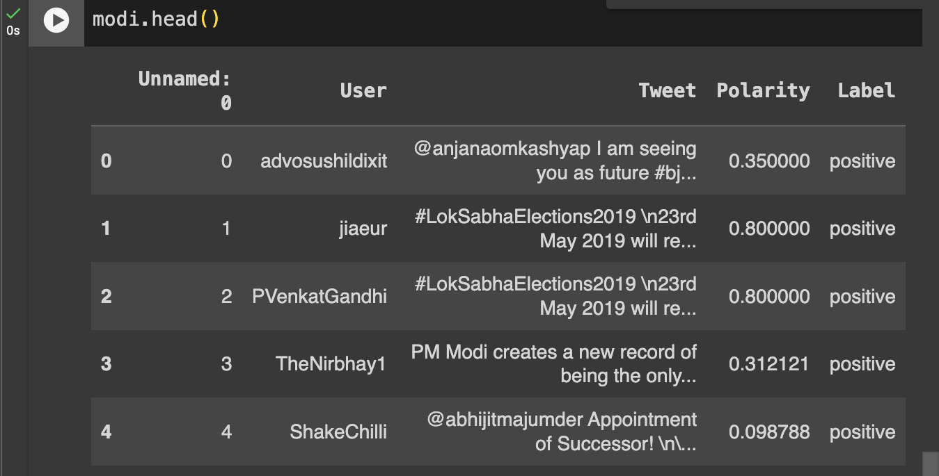
5.Categorizing the tweets based on their polarity

Slide 24
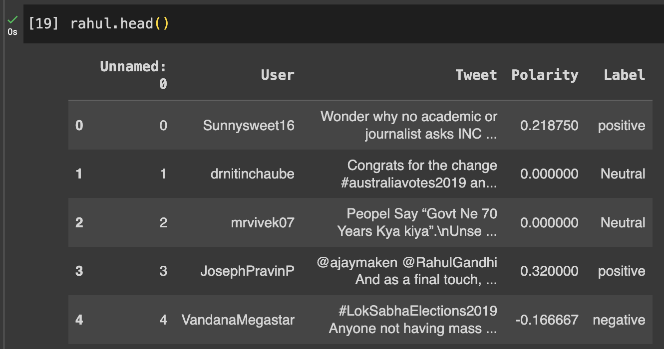
5.Categorizing the tweets based on their polarity

Slide 25
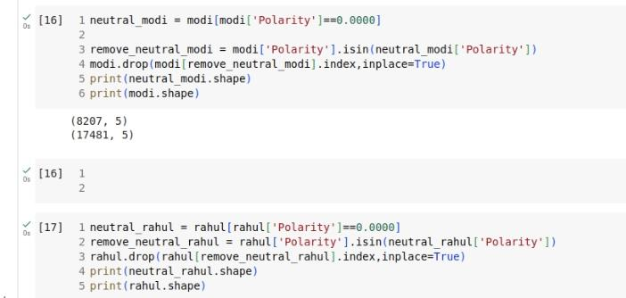
6.Removing Tweets with Neutral Polarity

Slide 26
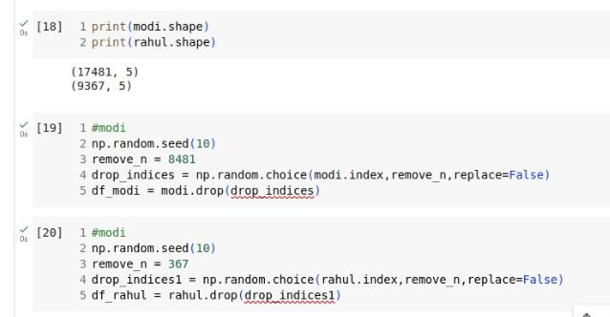
7.Droping the indices of the tweets with Neutral Polarity

Slide 27
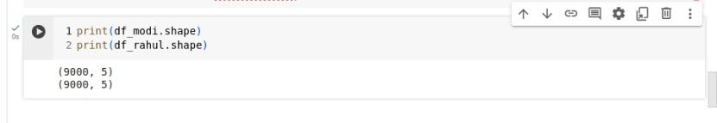
8.Final data set after removing neutral polarity tweets

Slide 28
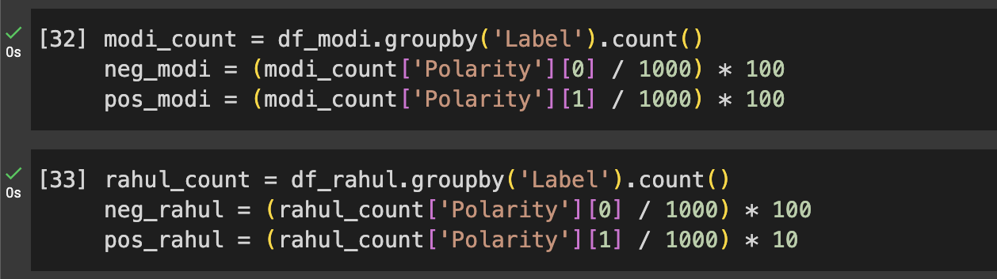
9.Prediction about Indian election
MODULE 4 - PREDICTION

Slide 29
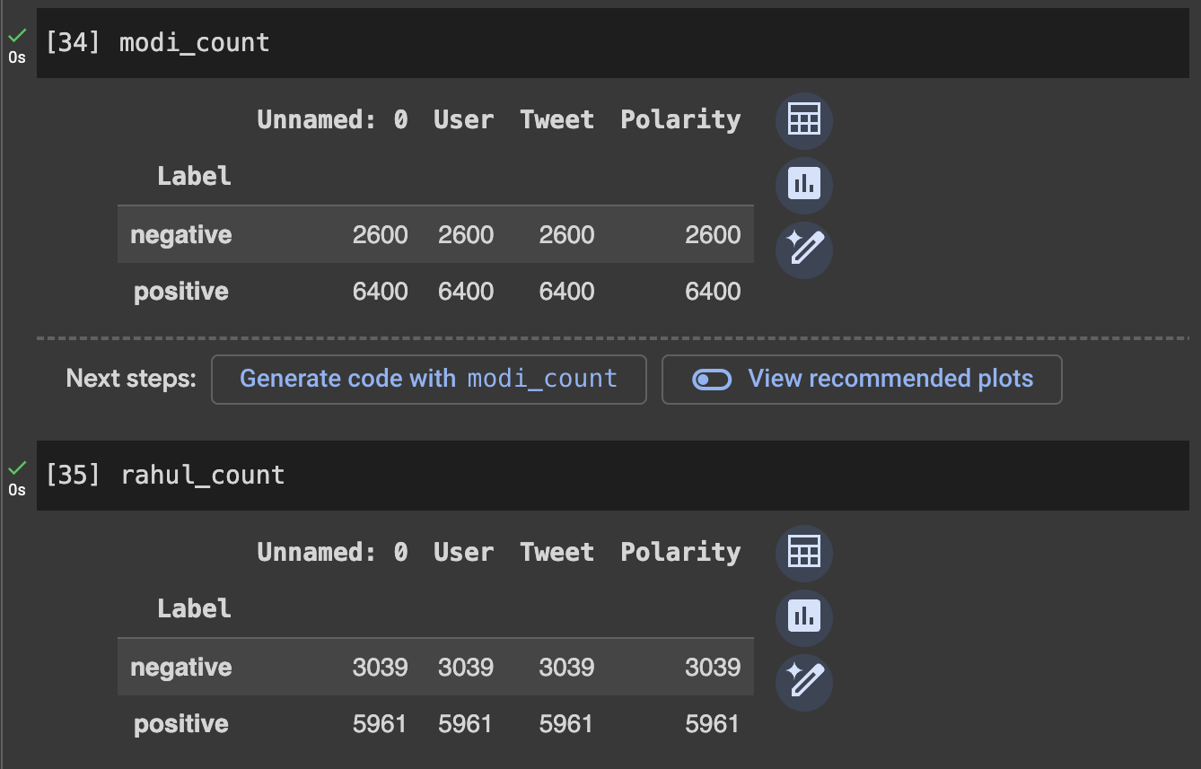
9.Prediction about Indian election

Slide 30
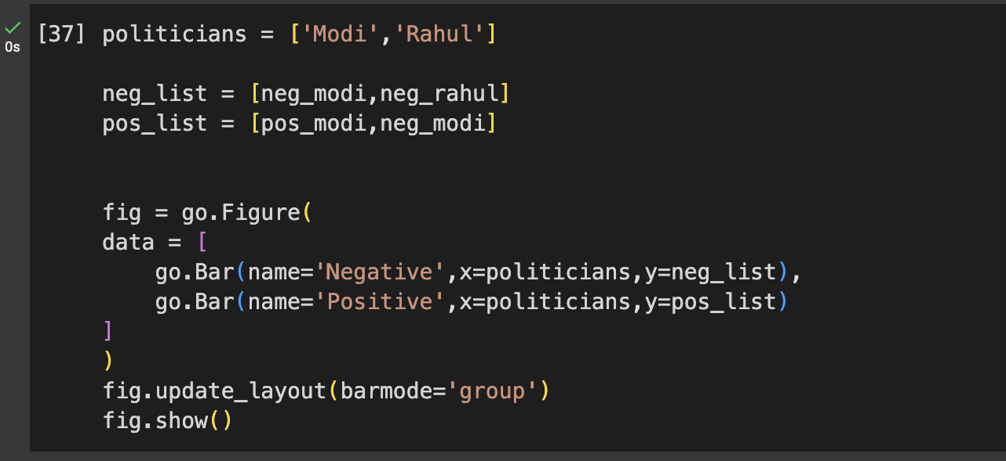
9.Prediction about Indian election

Slide 31
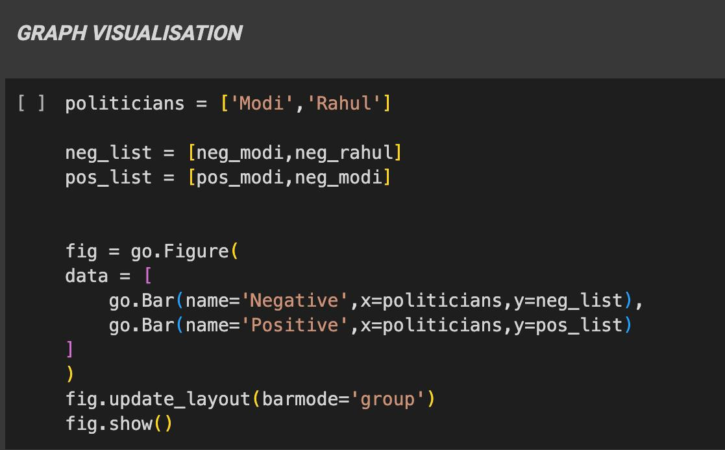
Results and Discussion
Predicting Indian elections involves collecting diverse data, selecting appropriate models, and training them with historical data. Once trained, these models are applied to current data to forecast election outcomes. Results are then validated against actual results if available. Despite efforts to account for various factors, predicting elections remains inherently uncertain due to evolving dynamics and unforeseen events.

Slide 32
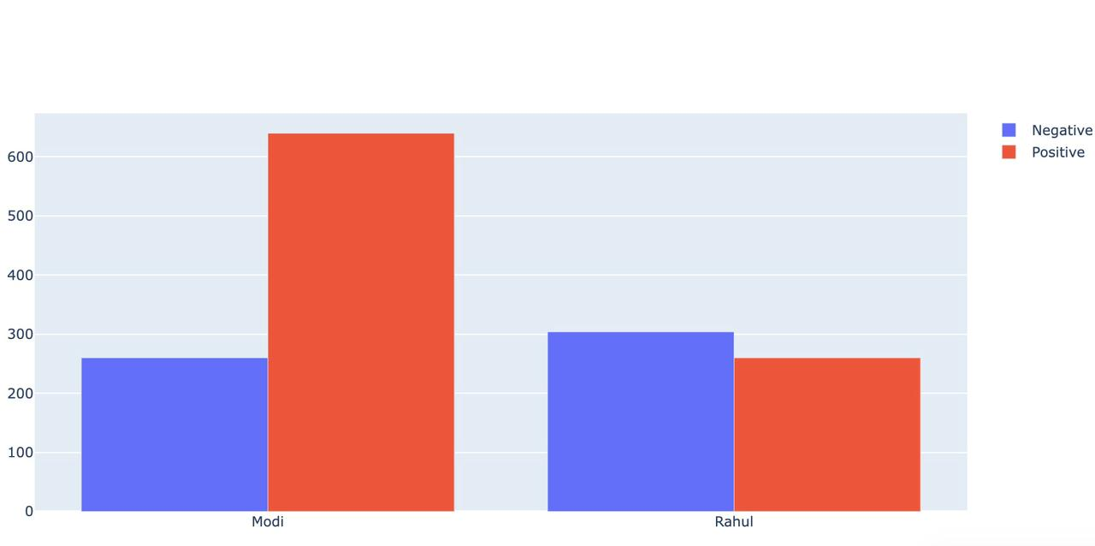
GRAPH VISUALISATION

Slide 33
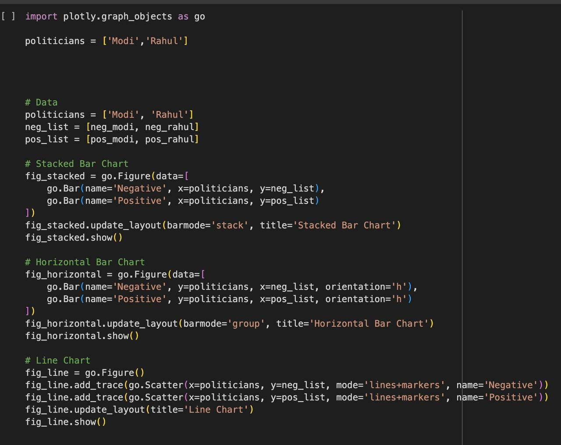
GRAPH VISUALISATION

Slide 34
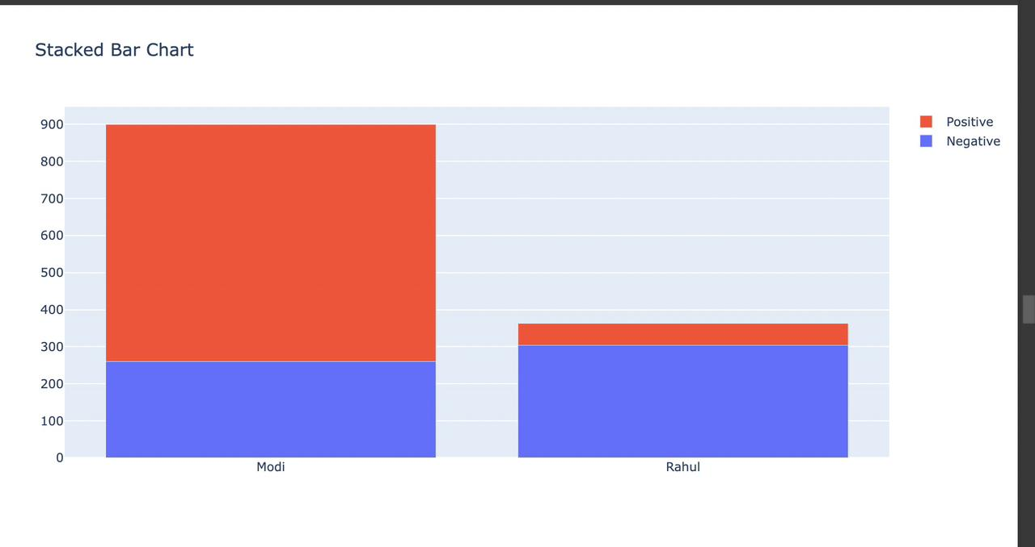

Slide 35
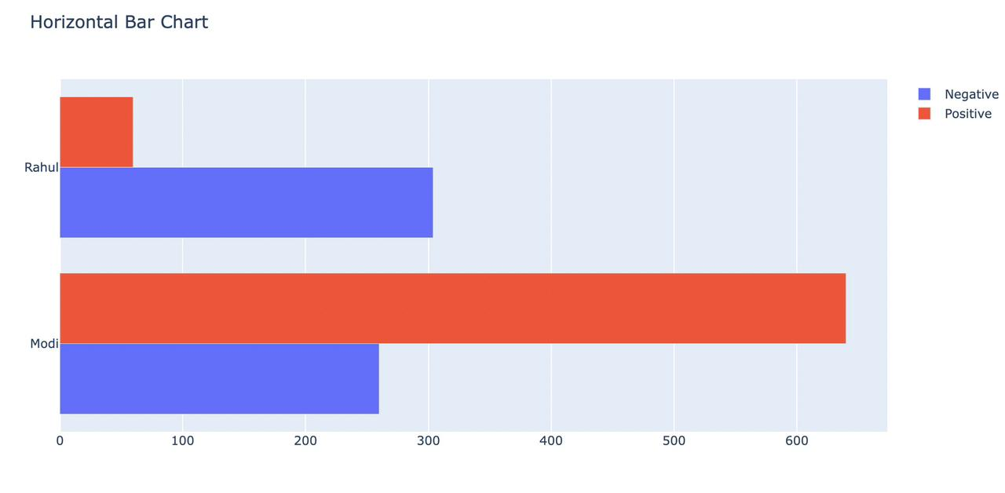

Slide 36
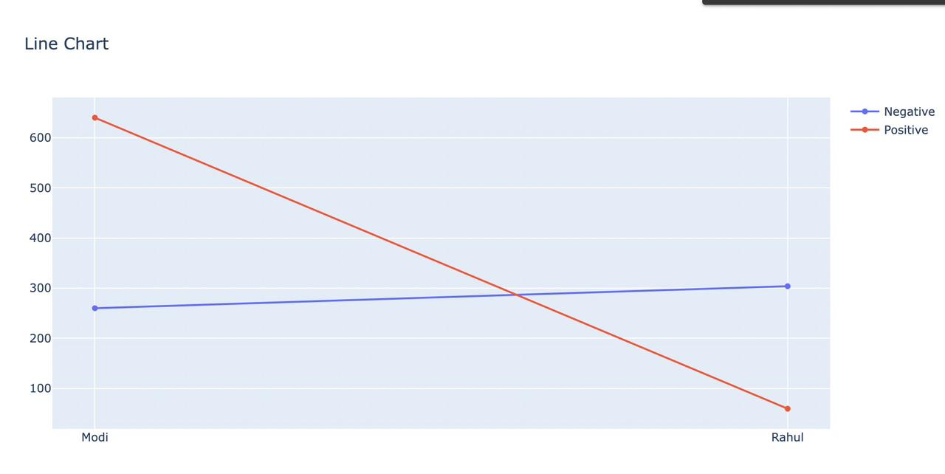

Slide 37
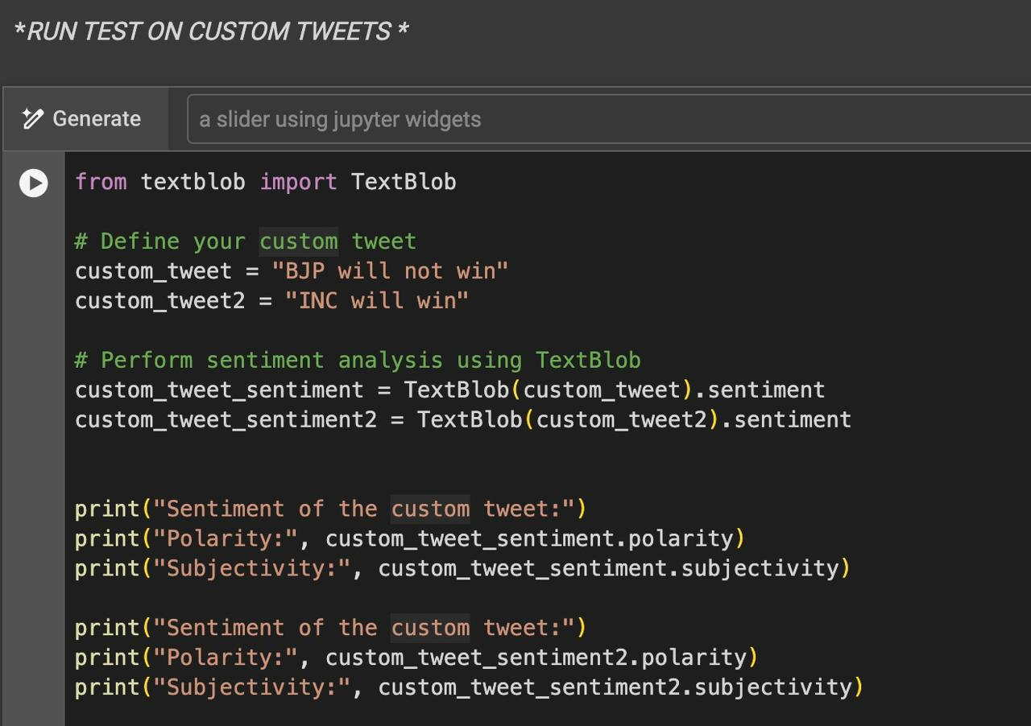
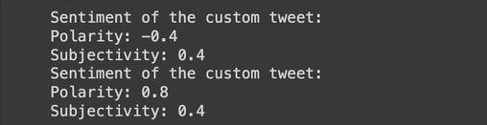
TEST – Running test on Custom tweets
OUTPUT

Slide 38
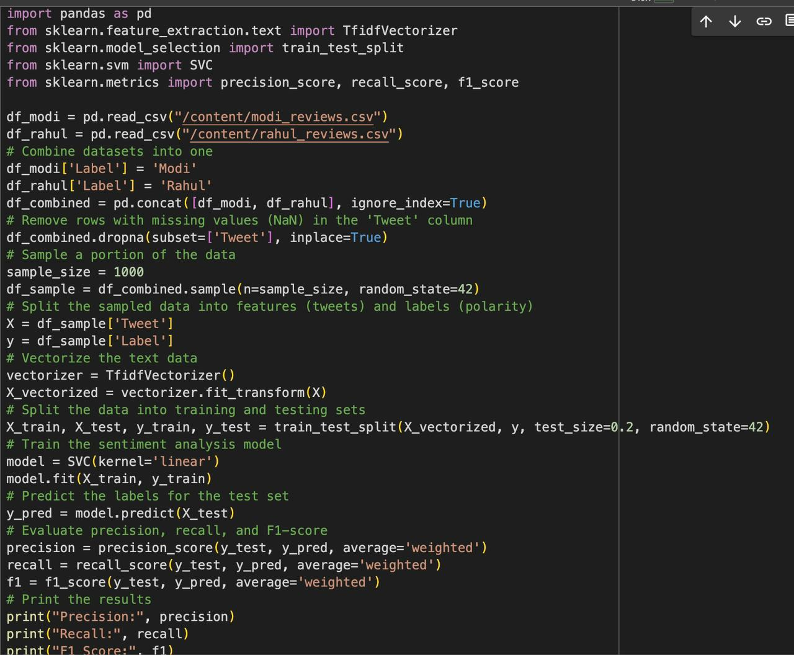
Applying SVM classifier
OUTPUT

Slide 39
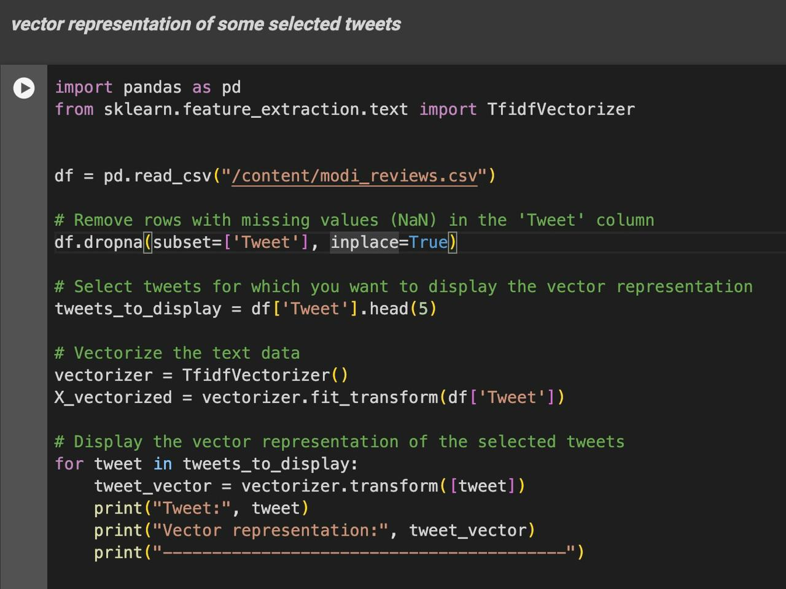
Vector representation of some selected tweets

Slide 40
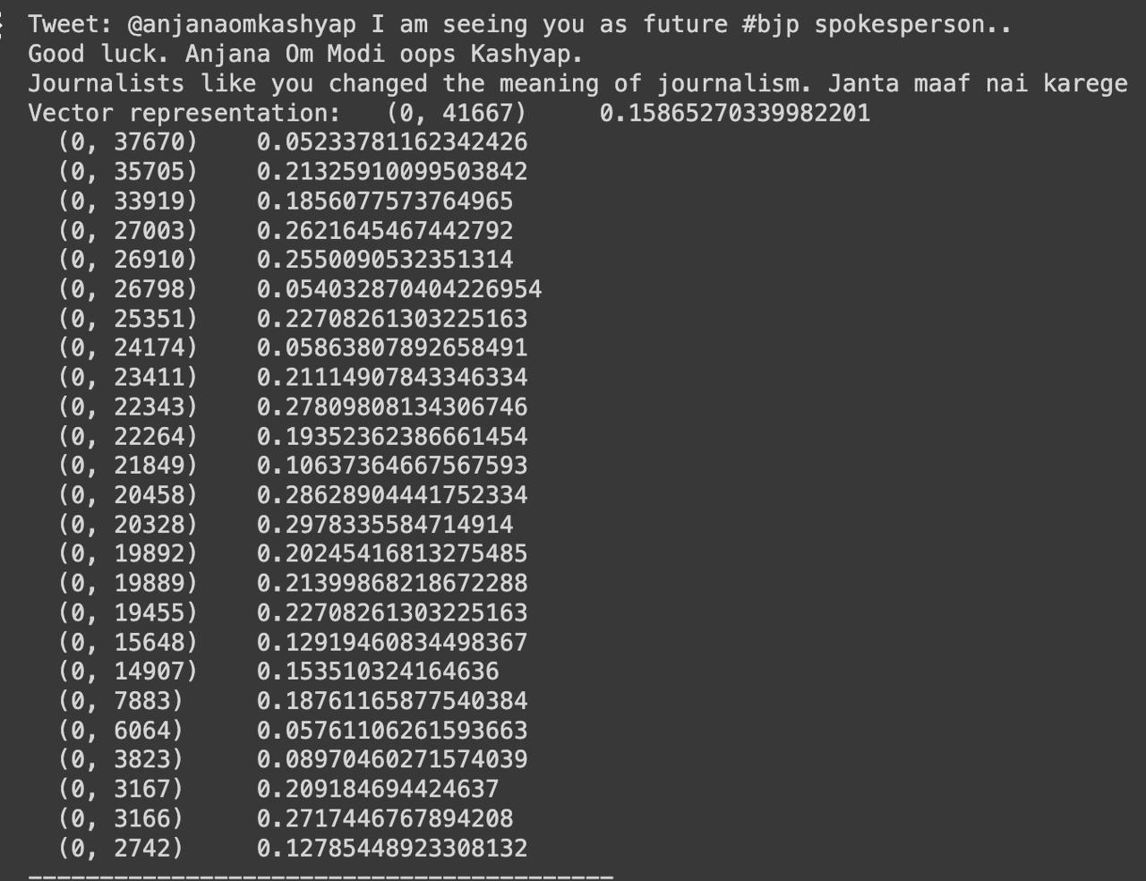
Vector representation of some selected tweets

Slide 41
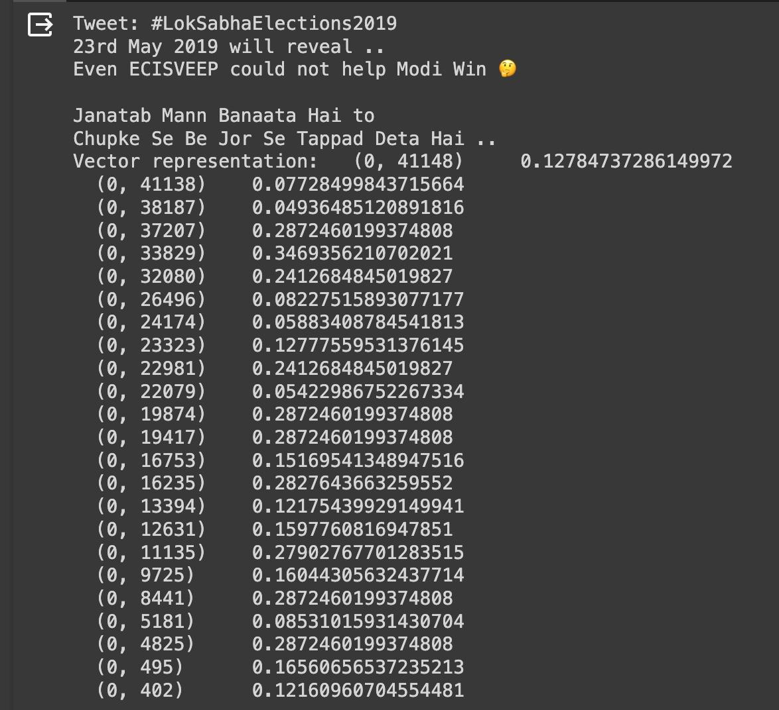
Vector representation of some selected tweets

Slide 42
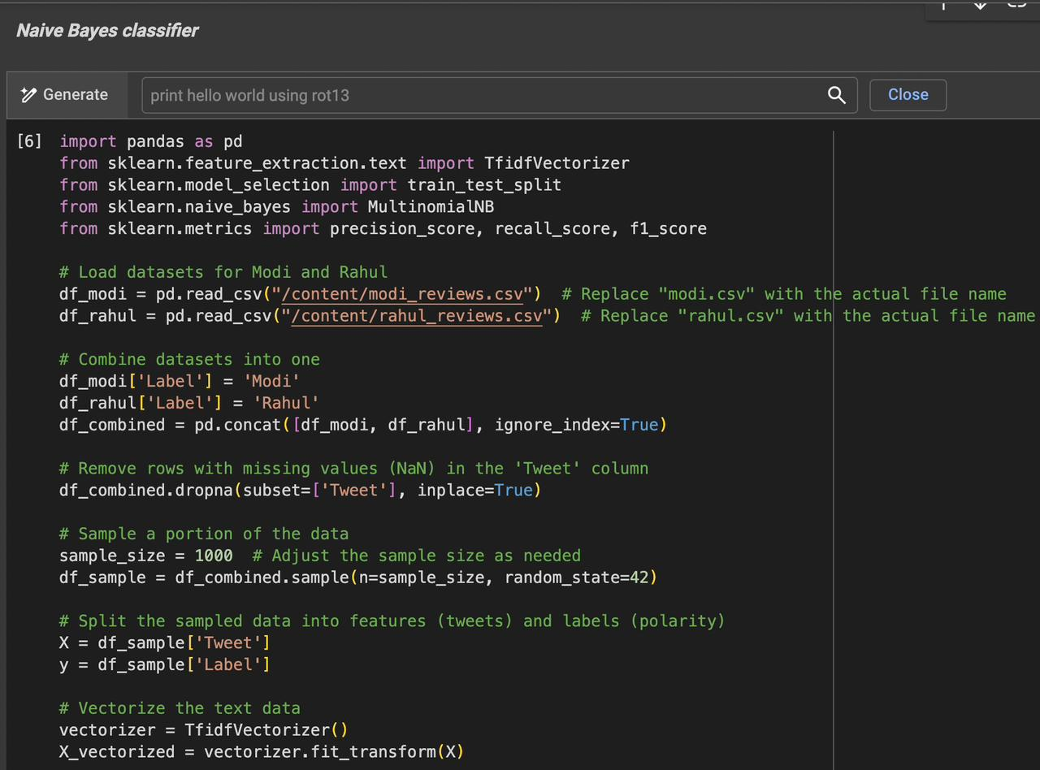
Applying Naive Bayes Classifier

Slide 43
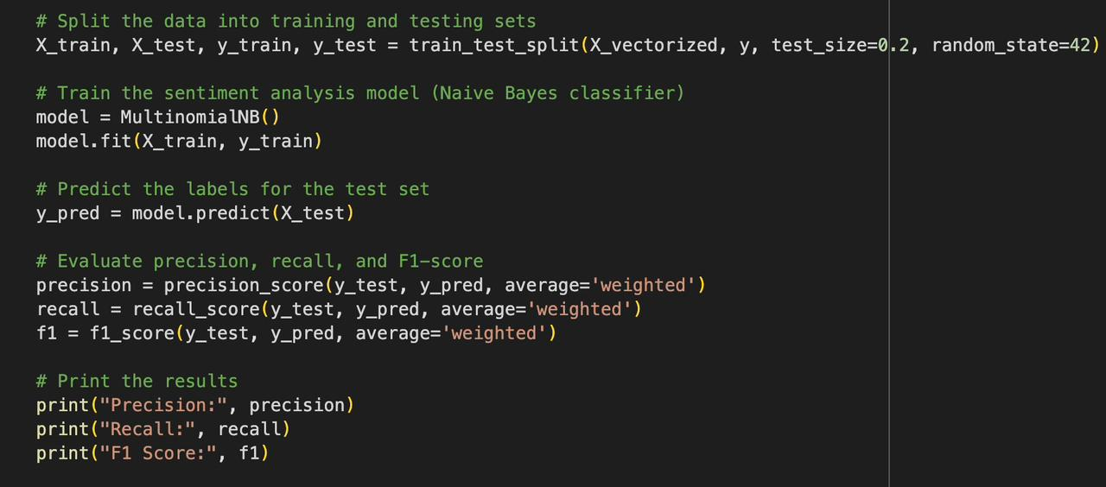
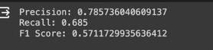
Applying Naive Bayes Classifier
OUTPUT

Slide 44
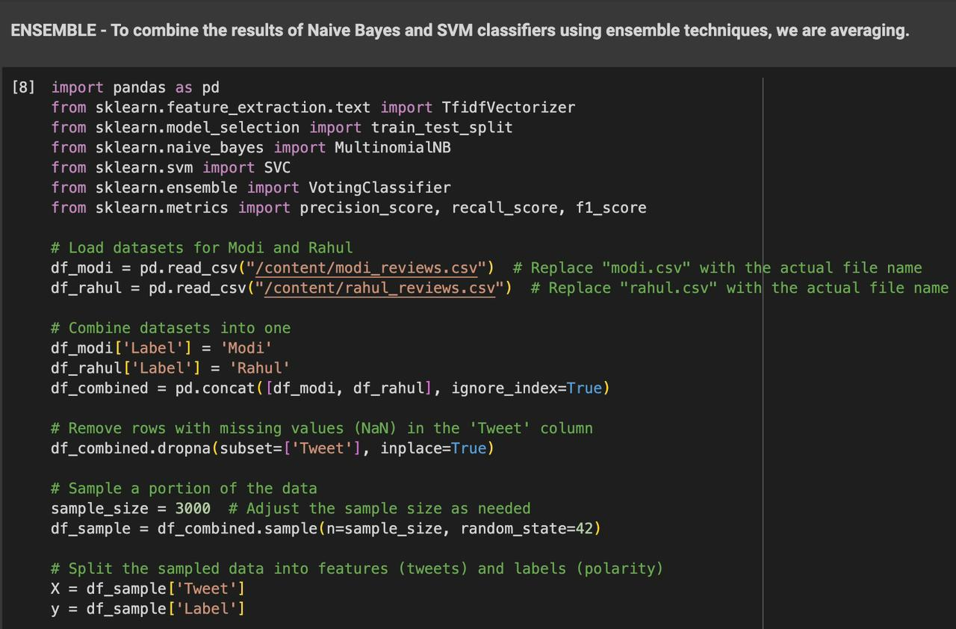
Ensemble – Combining the results of Naïve Bayes and SVM Classifiers

Slide 45
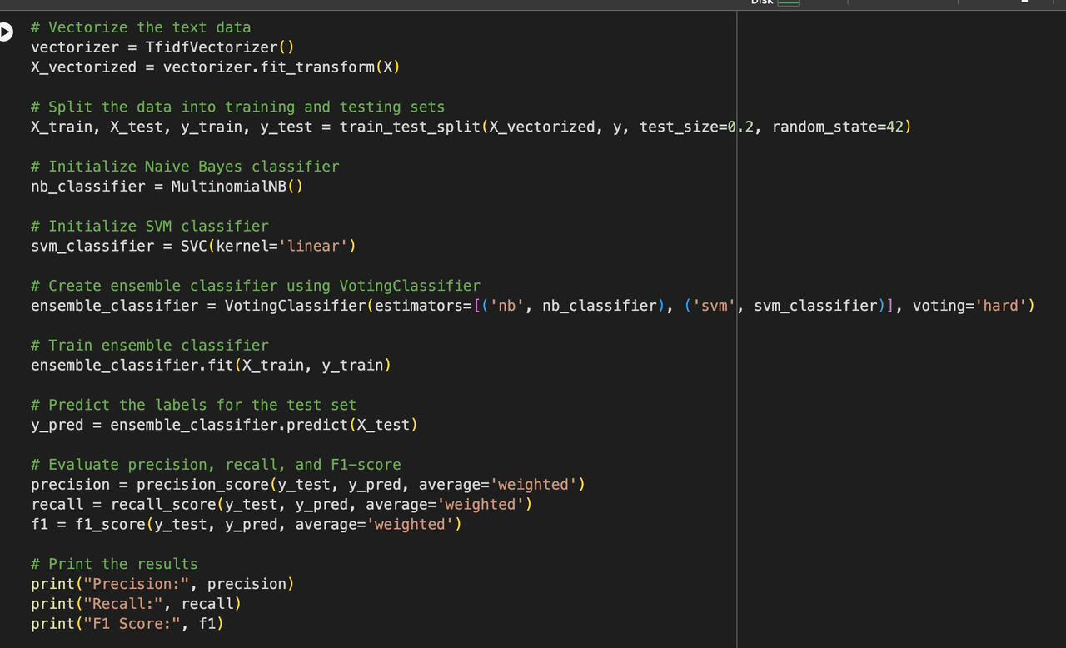
Ensemble – Combining the results of Naïve Bayes and SVM Classifiers
OUTPUT

Slide 46
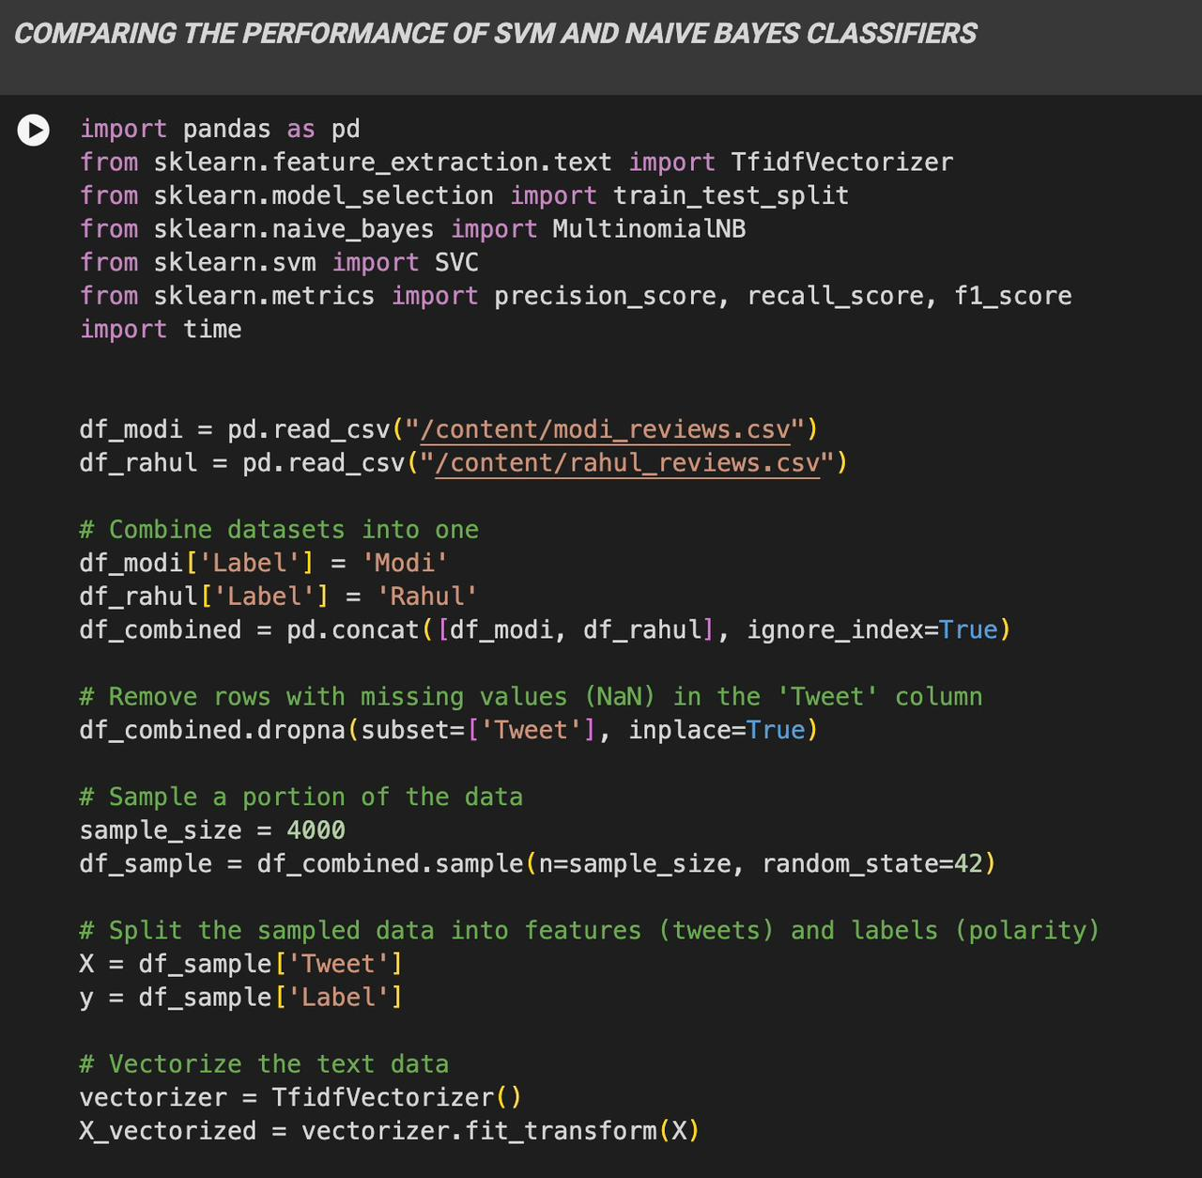
Comparing the performance of SVM and naive bayes classifiers

Slide 47
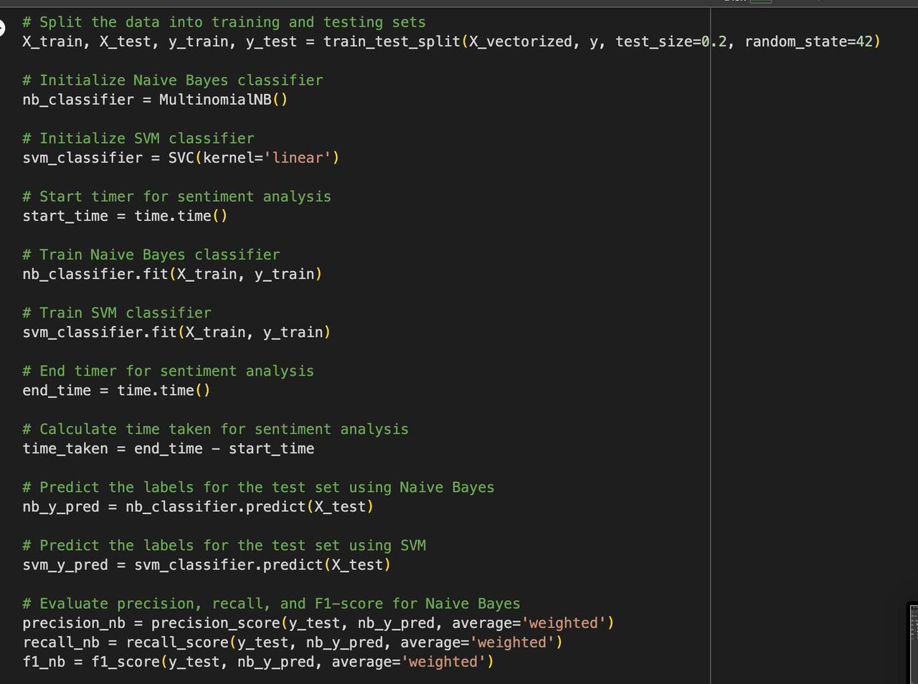
Comparing the performance of SVM and naive bayes classifiers

Slide 48
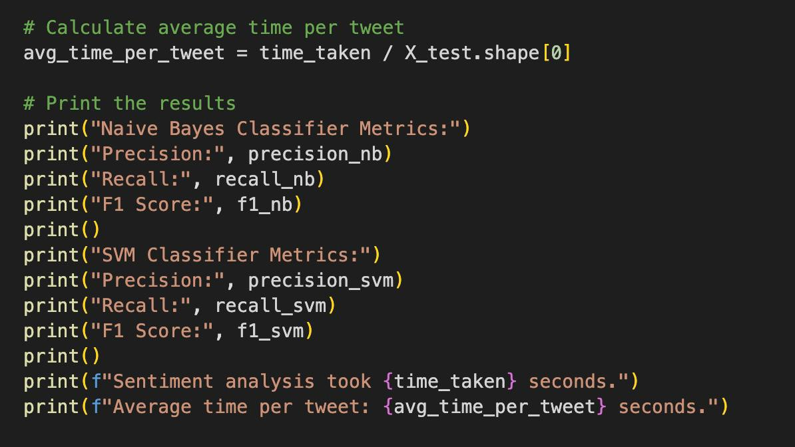
Comparing the performance of SVM and naive bayes classifiers

Slide 49
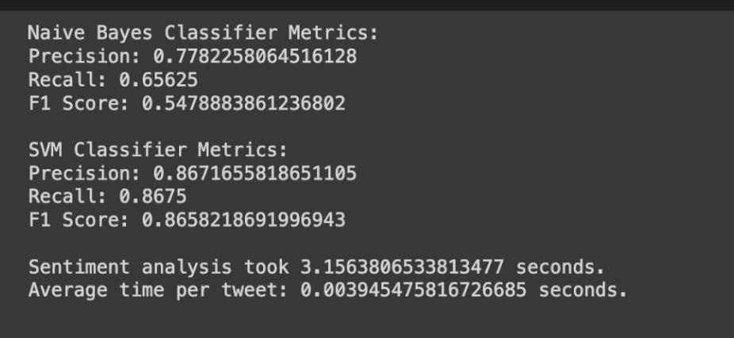
OUTPUT : Comparing the performance of SVM and naive bayes classifiers

Slide 50
CONCLUSION
This project highlights the significance of election sentiment analysis in modern politics, emphasizing the importance of understanding voter perspectives for effective campaigning and policymaking. By employing advanced data analytics techniques, including natural language processing and machine learning, the project aims to decode the sentiments expressed across various platforms.
Through rigorous analysis of textual data from social media, valuable insights into voter behaviours, preferences, and concerns are derived. These insights can aid political stakeholders in crafting informed strategies and fostering a deeper understanding of democratic processes. Overall, the project contributes to enriching the discourse surrounding electoral dynamics and empowers stakeholders to make data-driven decisions in the realm of modern politics.

Slide 51
FUTURE WORK
From our proposed work we come across as few tasks which can be performed to improve the accuracy of our prediction. Firstly we can create a dictionary of words containing translations for most recurring English words.
This would help us utilize the sentiment even more from the tweets that we extract, reducing the neutral tweet count. Secondly, we can use existing dictionaries for local dialect translation which would let us use other regional language tweets like Hindi, Tamil, Telugu etc. This would make our analysis more comprehensive to the region

Slide 52
REFERENCES
Fujihira, K., & Horibe, N. (2020, September). Multilingual sentiment analysis for web text based on word to word translation. In 2020 9th International Congress on Advanced Applied Informatics (IIAI-AAI) (pp. 74-79). IEEE.
2. Ilmania, A., Cahyawijaya, S., & Purwarianti, A. (2018, November). Aspect detection and sentiment classification using deep neural network for Indonesian aspect-based sentiment analysis. In 2018 International Conference on Asian Language Processing (IALP) (pp. 62-67). IEEE.
3. Li, G., Zheng, Q., Zhang, L., Guo, S., & Niu, L. (2020, November). Sentiment infomation based model for chinese text sentiment analysis. In 2020 IEEE 3rd international conference on automation, electronics and electrical engineering (AUTEEE) (pp. 366-371). IEEE.
4. Wang, Z., Chong, C. S., Lan, L., Yang, Y., Ho, S. B., & Tong, J. C. (2016, December). Fine-grained sentiment analysis of social media with emotion sensing. In 2016 Future technologies conference (FTC) (pp. 1361-1364). IEEE.
5. Woldemariam, Y. (2016, March). Sentiment analysis in a cross-media analysis framework. In 2016 IEEE international conference on big data analysis (ICBDA) (pp. 1-5). IEEE.

Slide 53
6. Budiharto, W., & Meiliana, M. (2018). Prediction and analysis of Indonesia Presidential election from Twitter using sentiment analysis. Journal of Big data, 5(1), 1-10. 43
7. Ibrahim, M., Abdillah, O., Wicaksono, A. F., & Adriani, M. (2015, November). Buzzer detection and sentiment analysis for predicting presidential election results in a twitter nation. In 2015 IEEE international conference on data mining workshop (ICDMW) (pp. 1348-1353). IEEE
8. Choy, M., Cheong, M. L., Laik, M. N., & Shung, K. P. (2011). A sentiment analysis of Singapore Presidential Election 2011 using Twitter data with census correction. arXiv preprint arXiv:1108.5520.
9. Hasan, A., Moin, S., Karim, A., & Shamshirband, S. (2018). Machine learning-based sentiment analysis for twitter accounts. Mathematical and computational applications, 23(1), 11.
10.Yavari, A., Hassanpour, H., Rahimpour Cami, B., & Mahdavi, M. (2022). Election prediction based on sentiment analysis using twitter data. International Journal of engineering, 35(2), 372-379.

Slide 54

THANK YOU!

